Slide 1

Robust Portfolio Management in Finance using Static Factor Models
Minimum-Risk Portfolio Optimisation with Polyhedral Uncertainty Sets
Nikita Swaroop
Supervisor: Dr Imad Jaimoukha
Notes:
Welcome to my presentation. My project focused on the field of portfolio optimisation – this is about distributing an investor’s wealth across assets to generate return and minimise risk.

Slide 2
Project Brief
Minimum-Risk Portfolio
Static Factor Models
Robust Optimisation
Polyhedral Uncertainty Sets
Notes:
During the 2020 COVID recession, a study found the 53% of investors moved a significant portion of their portfolio into lower risk assets. This demonstrates that, when faced with economic downturns, investors tend to pursue defensive, risk-averse strategies. We are currently facing another downturn, so it is fitting for this project to explore the minimum-risk portfolio problem.
In portfolio management, factor models are an effective tool for evaluating the risk return trade-off between assets.
However, investors don’t know the exact probability distribution of assets’ price movements, so there is uncertainty in their factor models.
Classical optimisation techniques do not account for uncertainty. Therefore, we turn to Robust Portfolio Optimisation.
In RPO, these uncertainties are modelled as deterministic sets. Existing RPO solutions aren’t adopted by investors in practice because they to produce overly-conservative returns.
This project will address the issue of low returns by creating a new formulation for the minimum-risk RPO problem using polyhedral uncertainty sets.

Slide 3


Linear Factor Model
$r= μ$ + $V^{T}f+ ε$
Total return on assets
Inherent return on assets
Factor Loading Matrix
Factor returns
Residual return on assets
Key Assumptions
Factor returns and residual returns are normally distributed: $f\sim ℵ\left(0,F\right), ε\sim ℵ\left(0,D\right)$
Asset returns are normally distributed:
$r\sim ℵ\left(μ, V^{T}FV+D\right)$
Portfolio returns ($w^{T}r$) are also normally distributed:
Expected return, $μ$_{p} = $w^{T}μ$
Risk , $σ_{p}^{2}$= $w^{T}V^{T}FVw+w^{T}Dw$
Sharpe ratio, SR = $\frac{Return}{Risk}$
The probability distributions of factor model parameters remain constant over time
Static Factor Model
Notes:
Before we discuss the new RPO formulation, we need to discuss the linear factor model for asset returns, and key assumptions that this project was build on.
The first term in the factor model, mu, is a constant, and it’s the average asset return
The second term represents how much of the asset’s total return can be explained by the factors. This term consists of the actual factor returns themselves, in matrix f, and the factor loading matrix V, which contains each assets sensitivity to each factor.
The final term is the residual returns, which represents the return that cannot be explained by the factor model. This is uncorrelated to the factor returns.
We make two key assumptions on the probability distributions of the model parameters:
Firstly, that the factor and residual returns are normally distributed, which allows us to model total asset returns as a random normal variable.
Then portfolio returns also have normal distribution. Then we have 3 performance metrics for a portfolio:
The return is then the expected value, risk is the variance of the portfolio, and Sharpe ratio, is equal to the return over risk. Sharpe ratio gives us an overview of the risk-return tradeoff of the portfolio. W is the vector of portfolio weights.
Secondly, we assume the probability distributions of the model parameters are stationary. This makes this factor model static – so the relationship between an asset and factor’s returns is constant over time.

Slide 4

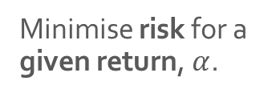
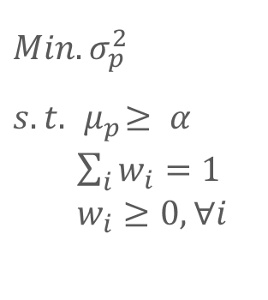
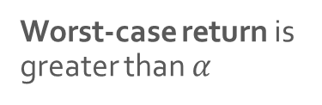
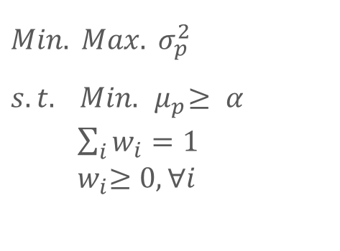
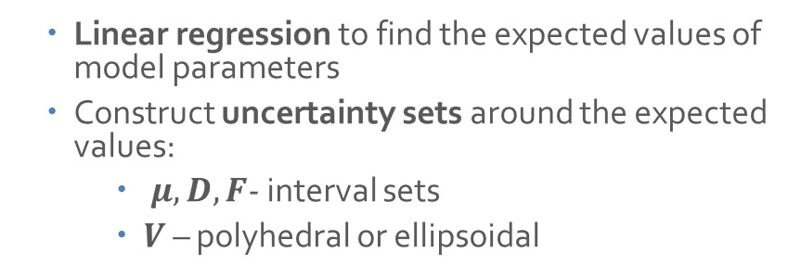
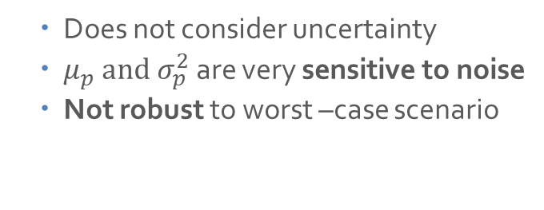
Classical Optimisation | Robust Optimisation
$$Min.{σ_{p}^{2}}$$
$$s.t. { μ}_{p}≥ α$$
$\sum_{i}{w_{i}}=1$
$w_{i}≥0,∀ⅈ$
$$Min. Max.{σ_{p}^{2}}$$
$$s.t. Min.{ μ}_{p}≥ α$$
$\sum_{i}{w_{i}}=1$
${ w}_{i}≥0,∀ⅈ$
Minimise worst-case risk
Minimise risk for a given return, $α$.
Worst-case return is greater than $α$
Budget Constraint
No short-selling
Budget Constraint
No short-selling
Does not consider uncertainty
${μ_{p} and σ}_{p}^{2}$are very sensitive to noise
Not robust to worst –case scenario
Linear regression to find the expected values of model parameters
Construct uncertainty sets around the expected values:
$μ, D, F$- interval sets
$V$ – polyhedral or ellipsoidal
Notes:
We’ll now compare a classical Minimum-risk optimisation to the robust MR optimisation.
In the classical optimisation, we don’t consider uncertainty. We just minimise the portfolio risk for a certain level of return. There is also the budget constraint – which means we cannot invest more than what we have. Also the no short selling constraint means we can’t have negative portfolio weights.
The mean and variance statistics are very sensitive to noise, so the classical portfolio performs very poorly in the worst case scenario.
By contrast, RPO is a minimax problem – we are minimising the worst-case (or maximum possible) risk over an uncertainty set. The constraints also ensure that the worst case (or lowest possible) return in an uncertainty set is greater than a level, alpha.
We use linear regression to find the expected values of the linear factor model parameters, and construct uncertainty sets around them. The average returns, and the covariance matrices of the factor and residual returns, have interval uncertainty sets.
The factor loading matrix will have a ellipsoidal or polyhedral portfolio.

Slide 5
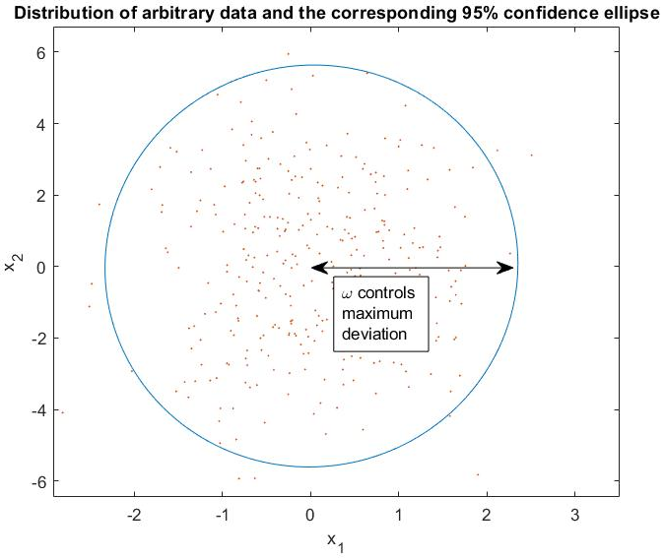
Ellipsoidal Uncertainty RPO
Robustness is controlled by confidence level, ω
SOCP
Generates low returns
Notes:
Now we discuss the ellipsoidal uncertainty set. This set is widely used in literature because it is simple to implement and can be solved efficiently.
The graph shows various instances of two variables, x_1 and x2, as well as the ellipsoidal uncertainty set around them.
Omega – confidence level- controls the max dev of the uncertainty set from the nominal value of the variable. A larger confidence level includes more instances of the uncertain variable, and will lead to a more robust solution.
Minimum-risk RPO with this set is implemented as a Second Order Cone Program – a type of convex program that can be solved efficiently.
This formulation is know to give conservative returns compared to the classical optimisation.

Slide 6
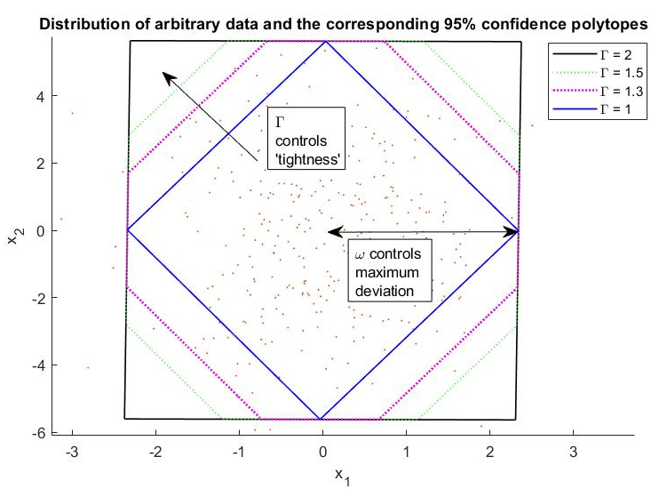

Polyhedral Uncertainty RPO
Intersection of the $L_{1}$ and $L_{∞}$ norms
Robustness is controlled by confidence level, ω, and budget of uncertainty, Γ
SDP
Notes:
Now this is an illustration of the polyhedral set.
It is defined as the intersection of the L1 and L∞ norms. (The L1 norm is the diamond shape, and the L∞ norm is the box shape)
The two norms play different roles in the characterisation of the uncertainty set:
• The L∞ norm is a box norm constrained by the confidence level ω. This norm fixes the maximum deviation of the uncertainty set.
• The L1 norm is constrained by Γ, which is a user-defined parameter called the budget of uncertainty.
Γ that controls the tightness of the uncertainty set by increasing the “radius” of the L1 norm, which increases the overall intersection area between the L1 and L∞ norms.
When Γ = 1, L1 ∩ L∞ = L1, since the L1 region is fully enclosed inside the L∞ region.
When Γ = the number of assets, L1 ∩ L∞ = L∞ because the L1 region has expanded and completely encloses the L∞ region.
For inbetween values of Γ, the norm has an octagon shape.
This formulation is implemented as a Semidefinite Program.

Slide 7
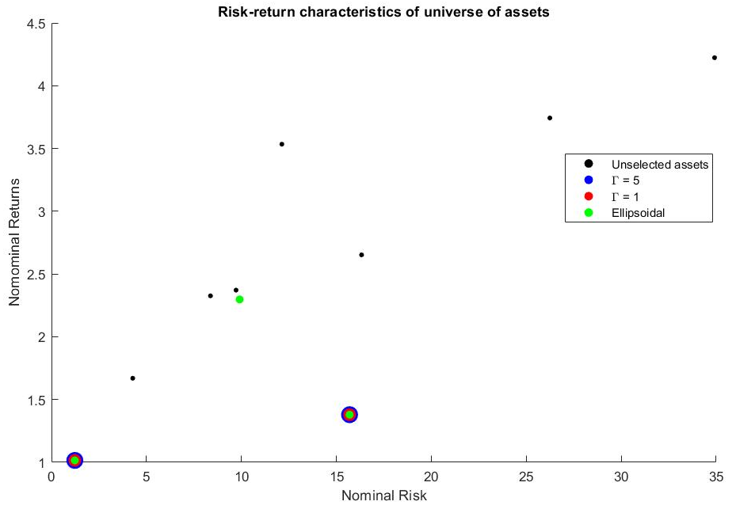
Diversification characteristics on Synthetic data
Assets with significant weight (above 0.01) in the polyhedral or ellipsoidal portfolios are colour-coded according to the legend.
Notes:
Now we’re going to check that the polyhedral RPO behaves as expected by testing it on a synthetic dataset.
The graph shows the risk return characteristics of the 10 assets in the synthetic universe. We see that there is a tradeoff – to get more return, you need to take more risk.
The graph has also colour coded any assets that held significant weight in any robust policy according to the key.
The polyhedral policies are less diverse than ellipsoidal policies. They only select 2 assest, whereas ellipsoidal selects 3.
This is because the polyhedral algorithm optimises the L1 norm, which encourages sparsity in the weight vector.

Slide 8
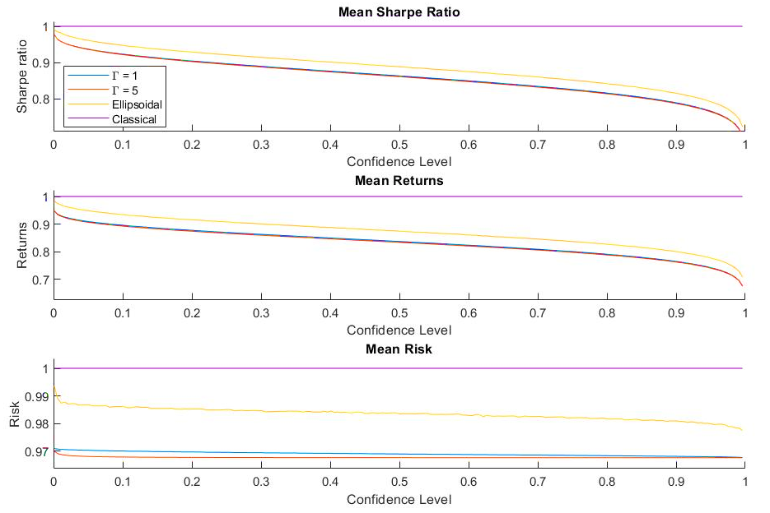
Mean performance of Classical and Robust policies on Synthetic data
Notes:
This relationship is reversed in the worst case. Now the RPOs half the risk of the classical policy, with only marginal contractions in returns.
They therefore have double the Sharpe Ratio of the classical policy.
Nonetheless, its difficult to justify 30% reduction in average performance for doubled during the worst case.
Therefore theses results suggest investors shouldn’t pursue robust strategies when the stock market is generally trending upwards.
The polyhedral RPOs produce lower risk than the ellipsoidal portfolio because it was able to concentrate wealth into the lowest risk assets. Overall, this is a disadvantage compared to the ellipsoidal portfolio, which took 1% more risk but generated 4% more return.

Slide 9
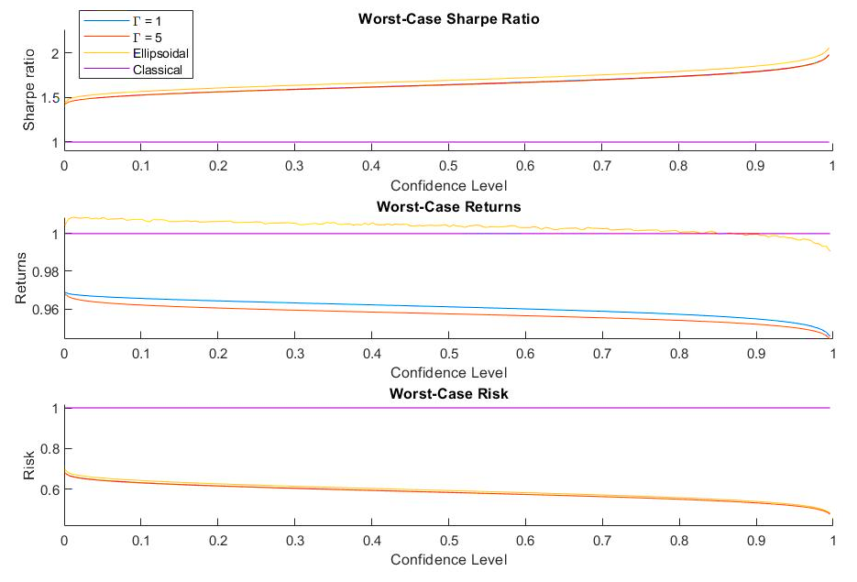
Worst-case performance of Classical and Robust policies on Synthetic data
Notes:
This relationship is reversed in the worst case. Now the RPOs half the risk of the classical policy, with only marginal contractions in returns.
They therefore have double the Sharpe Ratio of the classical policy.
Nonetheless, its difficult to justify 30% reduction in average performance for doubled during the worst case.
Therefore theses results suggest investors shouldn’t pursue robust strategies when the stock market is generally trending upwards.
The polyhedral RPOs produce lower risk than the ellipsoidal portfolio because it was able to concentrate wealth into the lowest risk assets. Overall, this is a disadvantage compared to the ellipsoidal portfolio, which took 1% more risk but generated 4% more return.

Slide 10
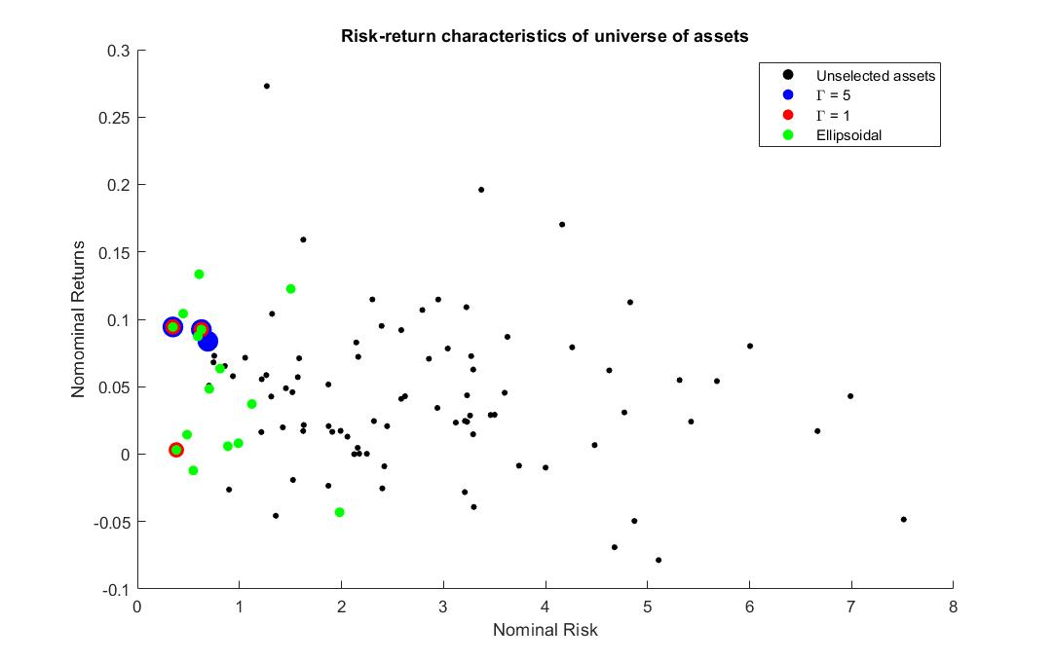
Diversification characteristics on Real-world data
Γ= 1 | Γ= 5 | Ellipsoid
Sainsburys | Sainsburys | Sainsburys
Ocado | Ocado | Ocado
Reckitt Benckiser | B&Q | Tesco
 |  | GSK
 |  | …
 |  | Unilever
 |  | Imperial brands
Notes:
Now we will implement the robust policies on the 2 year COVID pandemic period.
The assets are 99 stocks from the FTSE 100 index. 4 major stock indices have been used as factors - FTSE 100, NASDAQ, S&P 500 and DAX.
In this timeperiod, higher risk stocks were more likely to generate negative returns, so this dataset doesn’t have a risk return trade-off.
It is better to play defensive.
Once again, the polyhedral policies are much less diverse than ellipsoidal. They only pick 3 assets, while ellipsoidal picks 15.
From an intuitive perspective, the stocks picked by the polyhedral algorithm good investments, since demand for groceries stays constant over a pandemic.
The Gamma = 5 portfolio also picked B&Q (home and gardening store), and Gamma = 1 invested in Reckitt Benckiser (produces hygiene products like Dettol).
The hygiene and home products industries both directly benefited from the pandemic.
The ellipsoidal set is more diverse because doesn’t enforce sparsity, but this means that portfolio weight on stocks with negative return aren’t pushed to 0. This causes the ellipsoidal RPO to make some bad investments in losing stocks.
The stocks were Unilever (clothing) and Imperial brands (tobacco company), both of which suffered in covid.

Slide 11
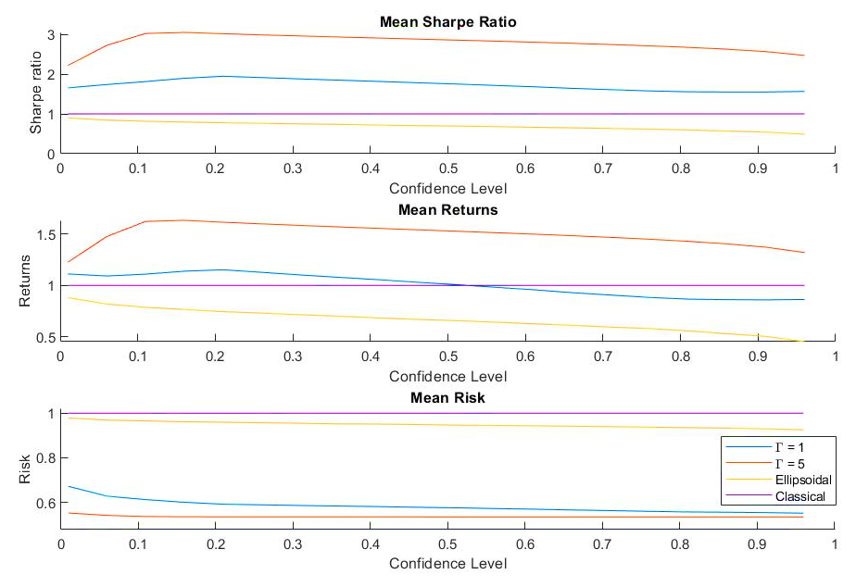
Mean performance of Classical and Robust policies on Real-world data
Notes:
Now we see that the Polyhedral RPO give almost half the risk of the classical policy in the mean case.
Also, the Γ = 5 portfolio actually outperforms the classical portfolio return by 30%. This leads to 2.5 times improvement in Sharpe ratio.
By contrast, the ellipsoidal portfolio still underperforms the classical policy on average.

Slide 12
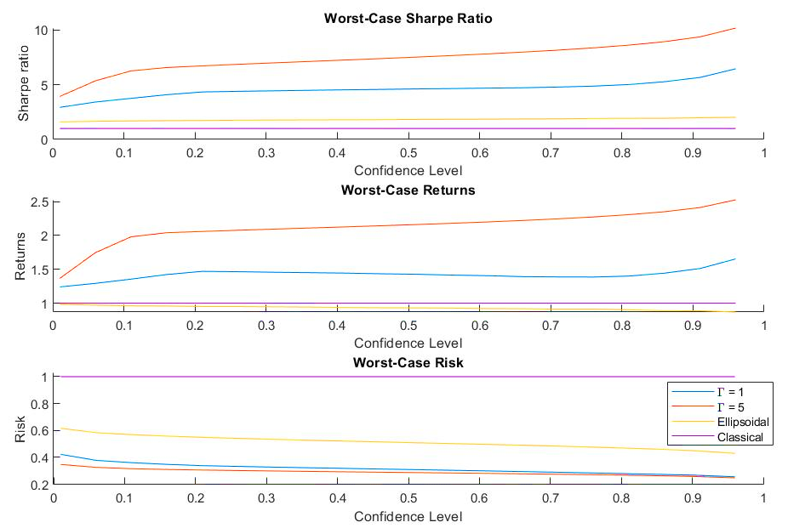
Worst-case performance of Classical and Robust policies on Real-world data
Notes:
In the worst case, the ellipsoidal policy has double the Sharpe ratio of the classical.
The Gamma = 1 policy has 6.5 times larger Sharpe ratio, and Γ = 5, gives an almost 10 times larger Sharpe ratio compared to the classical case.
These results show that during recessions, larger returns can be generated by concentrating wealth into stable assets that guarantee small returns, instead of spreading wealth across several higher risk assets that are likely to perform poorly.

Slide 13
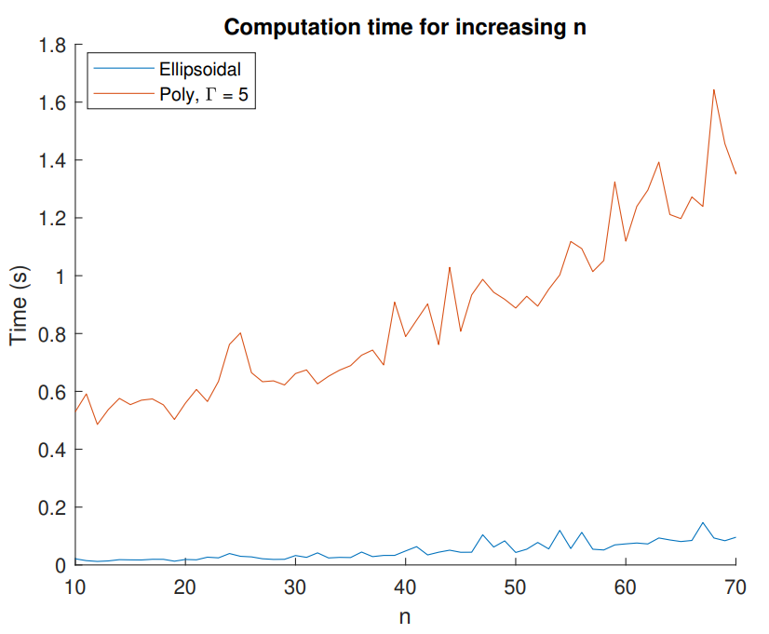
Computational complexity of Robust algorithms
Notes:
Finally we discuss the computational complexity of the RPO formulations.
The figure shows that as the number of assets, n, increases, the polyhedral algorithm has approximately cubic time complexity, while the ellipsoidal algorithm is approximately linear.
This is because SDP solvers are less efficient than solvers for SOCPs.

Slide 14
Advantages and disadvantages of polyhedral RPO
Advantages
Outperforms Classical Policy in returns and Sharpe ratio on stock market downturn data
Finds lowest risk portfolios compared
Disadvantages
Long algorithm run-rime
Poor diversification due to sparsity

Slide 15
Significance + conclusions
Novel Minimum-Risk RPO formulation using polyhedral sets
Shown that the algorithm generates higher returns than the classical policy during market downturns
Limitations: computational complexity, poor diversification, and assumption that uncertainty sets are symmetric

Slide 16
Further work
Use bootstrapping to estimate the covariance matrix D, rather than using linear regression
Reformulate the polyhedral algorithm into a SOCP, like the ellipsoidal algorithm
Construct polyhedral asymmetric uncertainty sets by adapting the following Maximum-Return problems for the Minimum-Risk case:
Chen et al. (2007) proposed an approach to construct asymmetric uncertainty sets using positive and negative perturbations in the the expected value of the uncertaint parameter.
Kawas and Thiele (2011) propose optimize over the log-normal distribution of stock returns. This approach also produced portfolios with greater diversification and risk performance than symmetric robust algorithms.

Slide 17
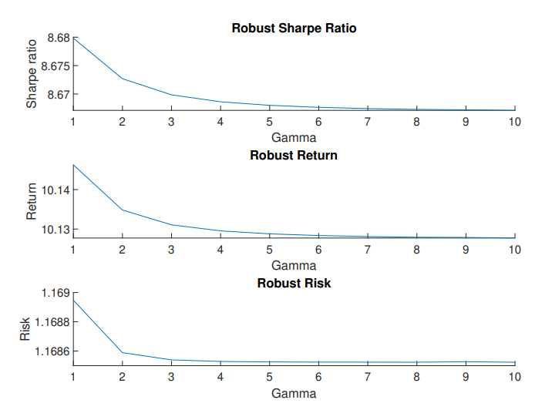
Gamma

Slide 18
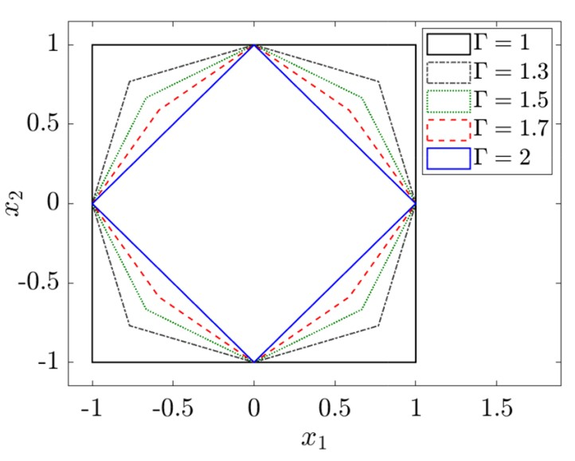
D-norm vs Intersection norm
D- norm
Intersection norm

Slide 19
Overview of Polyhedral RPO algorithm
Inputs
Polyhedral RPO
Vector of portfolio weights, w
Asset returns
Factor returns
Minimum portfolio return, alpha
Confidence level, omega
Budget of Uncertainty, Gamma
Risk
Outputs
Return
Sharpe Ratio

Slide 20
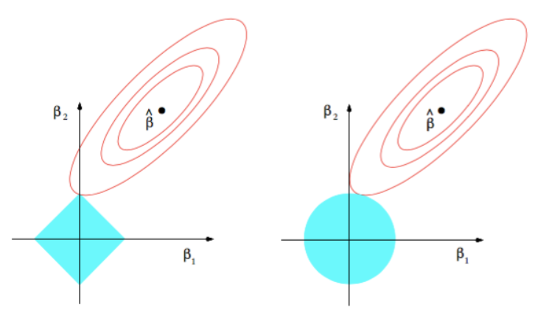
L1 norm sparsity

Slide 21
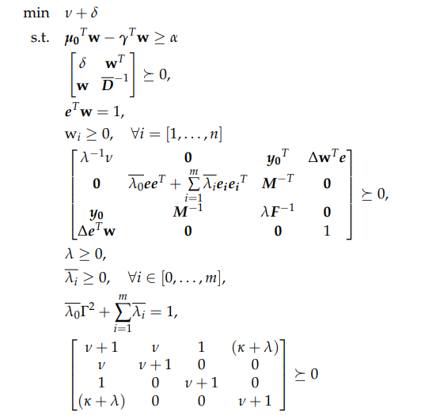
Final formulation

